Slide 1


Slide 2
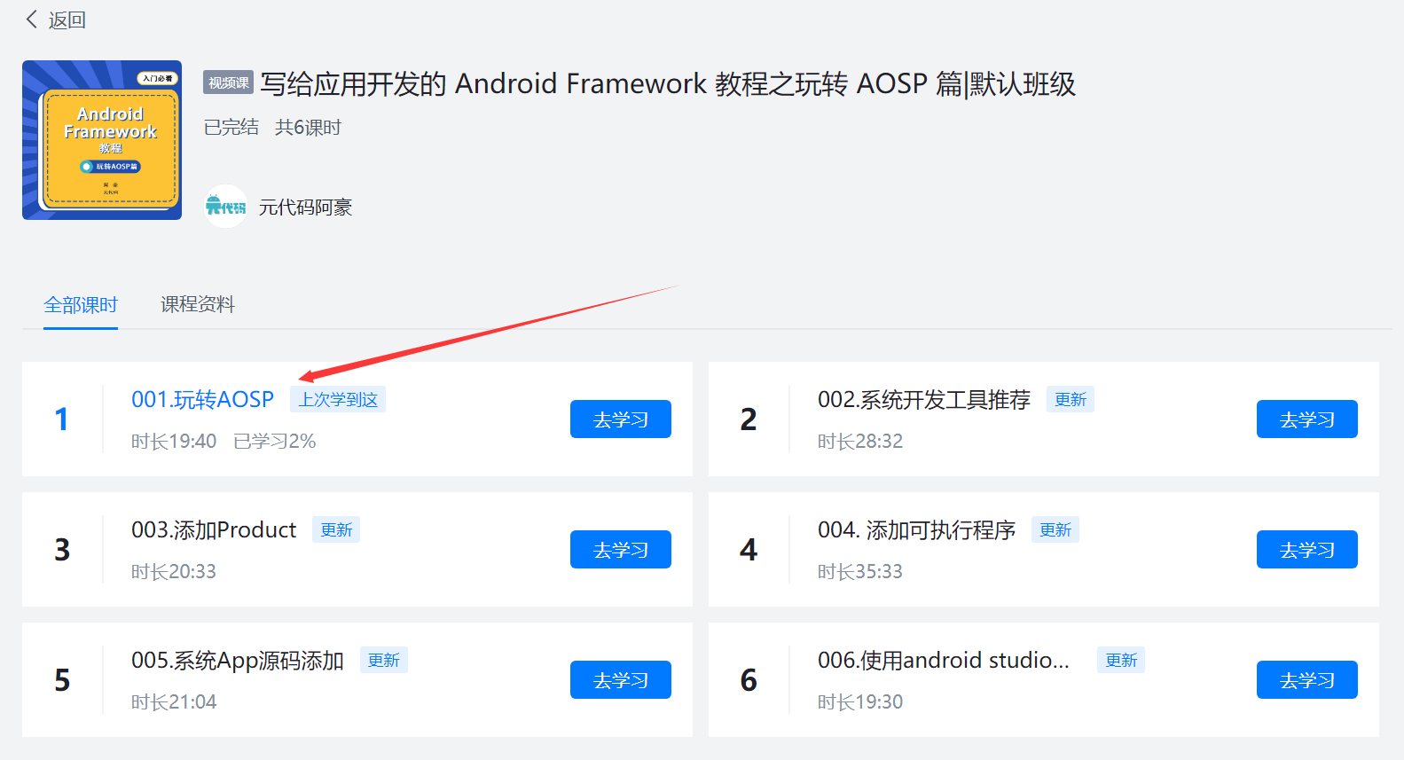
AOSP 下载编译

Slide 3
Kernel 下载编译运行
https://github.com/yuandaimaahao/AndroidBinderTutorial/blob/main/001.%20%E5%AD%A6%E4%B9%A0%20Binder%20%E7%9A%84%E9%A2%84%E5%A4%87%E7%9F%A5%E8%AF%86.md

